Slide 1
CBDC-TokenAI
UTXO

Slide 2
Agenda
Introduction
Problem
Solution
Architecture
Workflow
Summary

Slide 3
Introduction
The project develops a Deep Learning time-series prediction model to estimate future UTXO transaction amounts, which are then used to determine the optimal set of token denominations. These predicted tokens are pre-created and stored in the DTSP's MariaDB instance, ensuring that tokens are readily available when an Off-Us transfer request is initiated without facing token selection deadlock.

Slide 4
Problem
In UTXO Off-Us Transaction

Slide 5


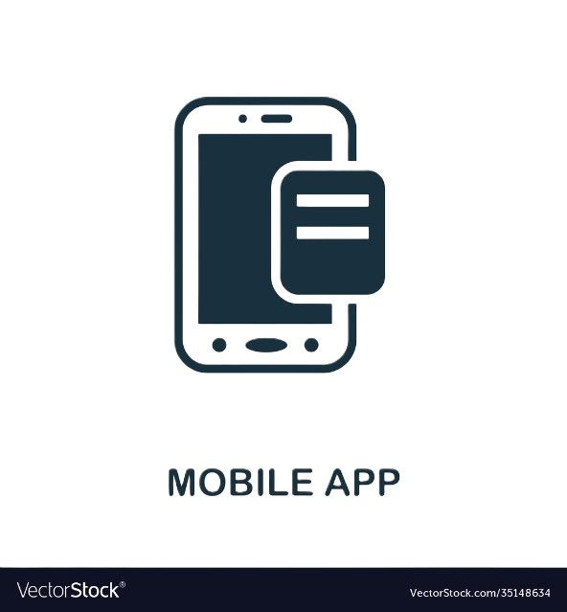
NPCI
DLT
Off-Us
Txn
Platform
DTSP
DTSP
Bank
PSO
Bank
RTSP
RTSP

Slide 6
NPCI
During Peak Traffic
DLT
Lag due to Token Splitting
Platform
DTSP
DTSP
Bank
PSO
Bank
RTSP
RTSP

Slide 7
Problem Statement
In an UTXO Off-Us transfer request, the system attempts to select high-value tokens from the available pool to satisfy the transaction amount. Once selected, these tokens are marked as LOCKED to prevent concurrent access and ensure atomicity of the transfer. However, this locking mechanism introduces a bottleneck during high-traffic times.
When multiple transactions simultaneously request high-value tokens—especially during peak loads tokens required by one transaction may already be locked by another. As a result, subsequent transactions are forced to wait until the locked tokens are released, leading to a token deadlock. This causes a queue buildup, where transactions are stalled, waiting for token availability.

Slide 8
Solution
CBDC-TokenAI: An AI Agent

Slide 9
NPCI
TokenAI
Pre-splits tokens
DLT
Platform
DTSP
DTSP
TokenAI
TokenAI
PSO
RTSP
Bank
RTSP
Bank

Slide 10
An Agentic AI Solution
To address the challenges of token splitting and transfer delays in CBDC UTXO’s Off-Us txns an DL model is employed to predict upcoming transaction values using historical transaction data. This model leverages temporal features to forecast the expected transactions for future transfers this is done bank-wise at every bank.
Based on these predictions, the system splits tokens in advance for better availability. Specifically, when we have high-volume of transactions coming in during peak times, it pre-splits large-value tokens into multiple smaller denominations. These smaller tokens are then stored in the MariaDB and DLT, ensuring they are readily available for future use.

Slide 11
Architecture
How does CBDC-TokenAI look like?

Slide 12



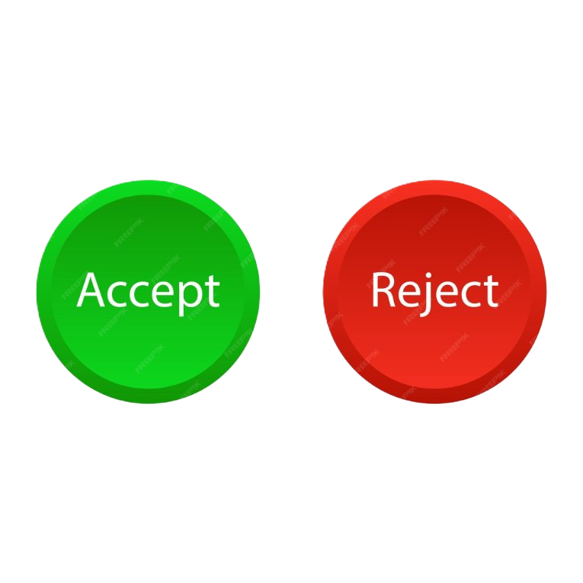

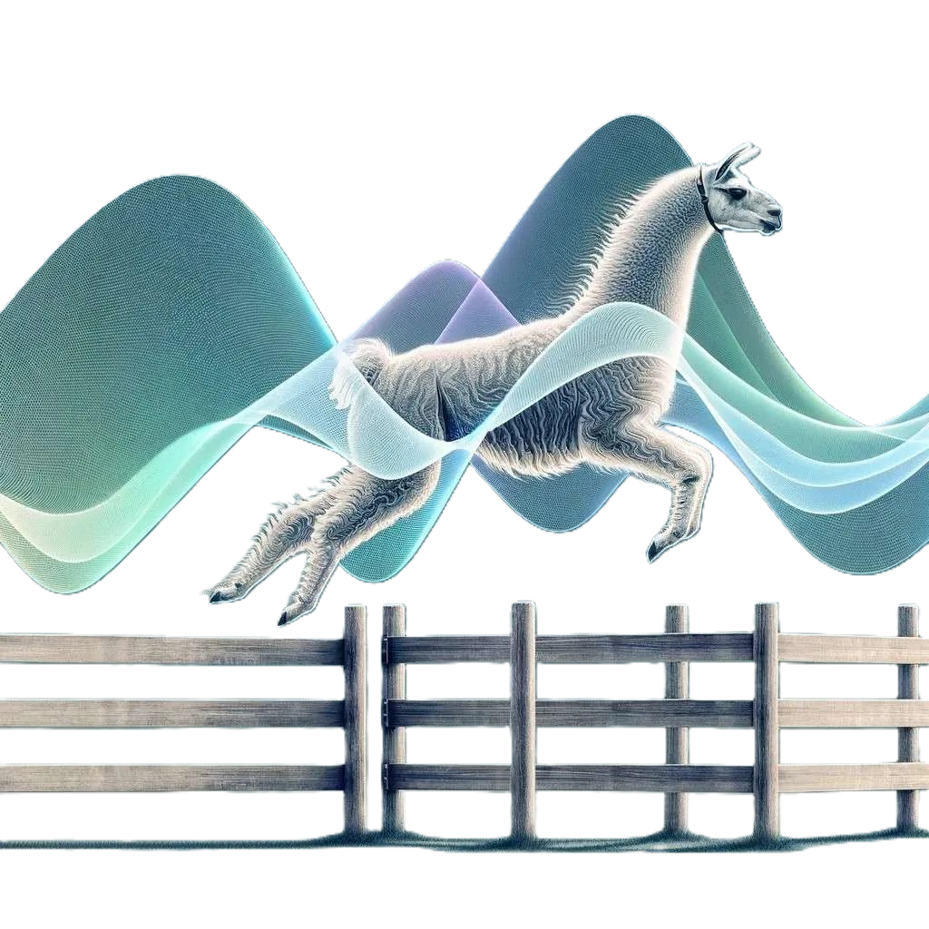





UI
CRUD
GET
POST
UTXO
DTSP
API
Server
Next day's data
AI AGENT
Token values
ȳ
Processed Token Values
Deployed
Predicted Txns
Server
DB
Store
SQLX
Fetch

Slide 13
Workflow
How does CBDC-TokenAI work?

Slide 14
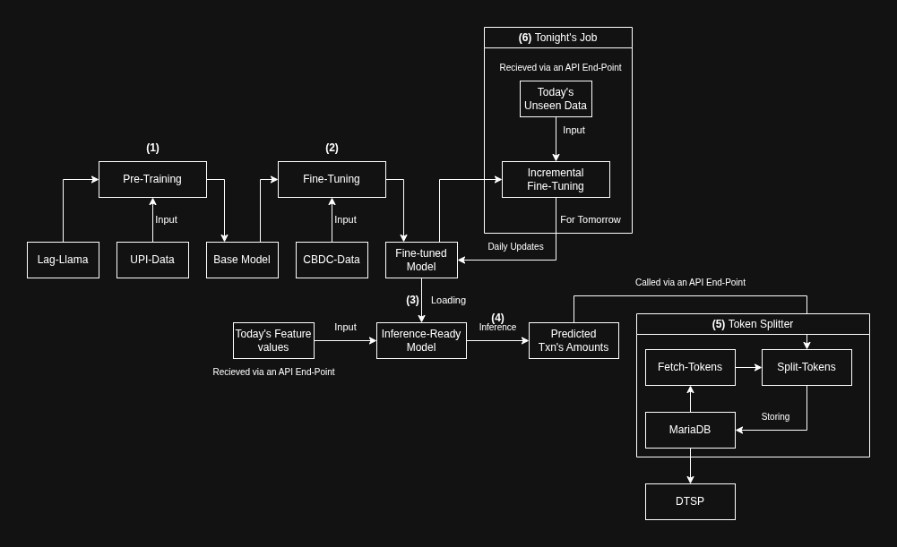



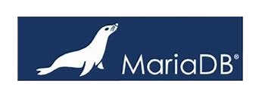
Lag-Llama Inference and Training

Slide 15
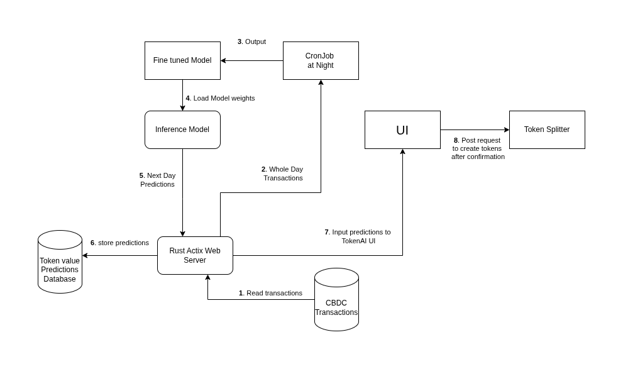
Rust Backend

Slide 16
Rules for Token Splitting
if txn.count >= 10 || txn.amount <= 100:
txn_token = txn.amount
else if txn.amount <= 500 && txn.amount > 100:
txn_token = 500
else if txn.amount <= 1000 && txn.amount > 500:
txn_token = 1000
else if txn.amount > 1000 && txn.amount < 5000:
txn_token = (txn.amount / 1000 + 1) * 1000
else if txn.amount > 5000:
txn_token = 10000

Slide 17
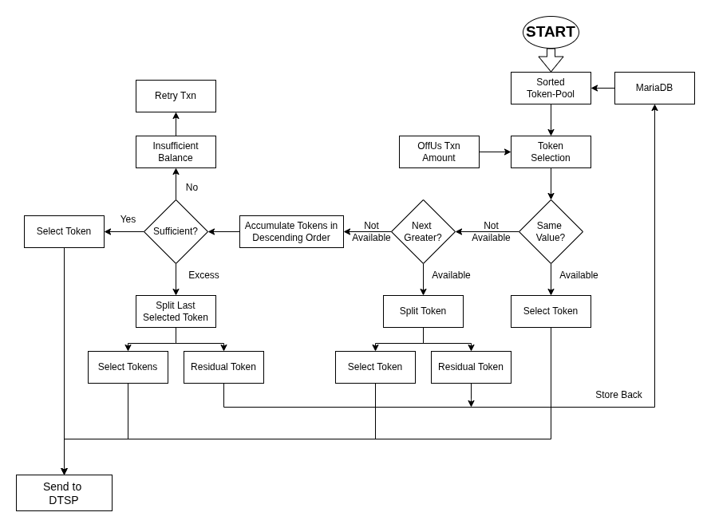
Token Selection Process

Slide 18
Summary
We use Lag-Llama on pre-trained on historical UPI data, fine-tune it on CBDC data for an inference ready model which can predict the upcoming transactions for the next day. These predictions are done bank-wise
With the help of these predictions, we pre-split the existing tokens at night or during times with low traffic. This enables us to avoid lag in the future.

Slide 19
Thank you

